Slide 1
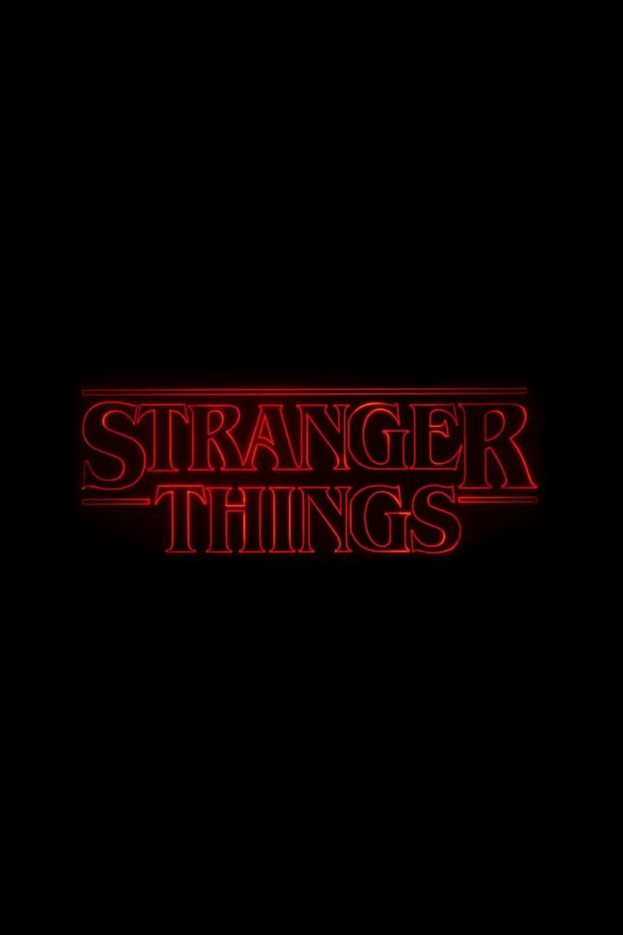
Hawkins Lab
Your classified assignment deep within the mysteries of Hawkins.
Prepare to breach the veil and venture into the Upside Down, directly from your browser.
Notes:
1

Slide 2
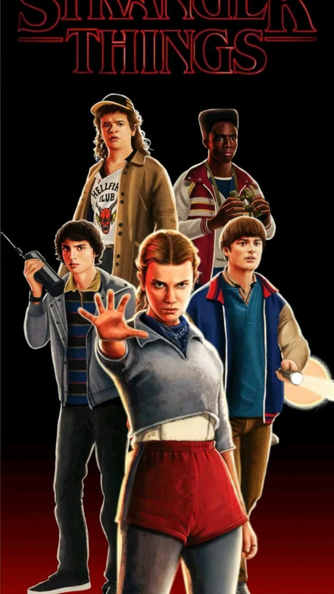
TOP SECRET: INNOVATION
Unlocking the Upside Down: The Vision
To forge a portal through the mundane digital realm, transforming a standard web interface into an immersive 1980s horror experience that perfectly recreates the iconic, eerie atmosphere of Hawkins.
Notes:
2

Slide 3
DESIGN PHILOSOPHY
The Concept
Inspired by Joyce Byers' iconic alphabet wall from Season 1, our concept plunges users into an immersive experience. We've forged a fully interactive communication device that feels less like a website and more like a fragile portal, whispering secrets from the Upside Down.
Hawkins-Era Technology
The Byers' Homestead Touch
Dive into the familiar glow of CRT screens, the subtle dance of scanlines, and the vintage phosphor aura—evoking the classic 80s tech that helped our heroes communicate across dimensions, like Dustin's trusty walkie-talkie.
Every detail, from the sagging, stressed wires to the trembling, hand-painted letters and the frantic, glowing vintage bulbs, screams authenticity, directly channeling the desperate communications from Joyce's living room.
Notes:
3

Slide 4
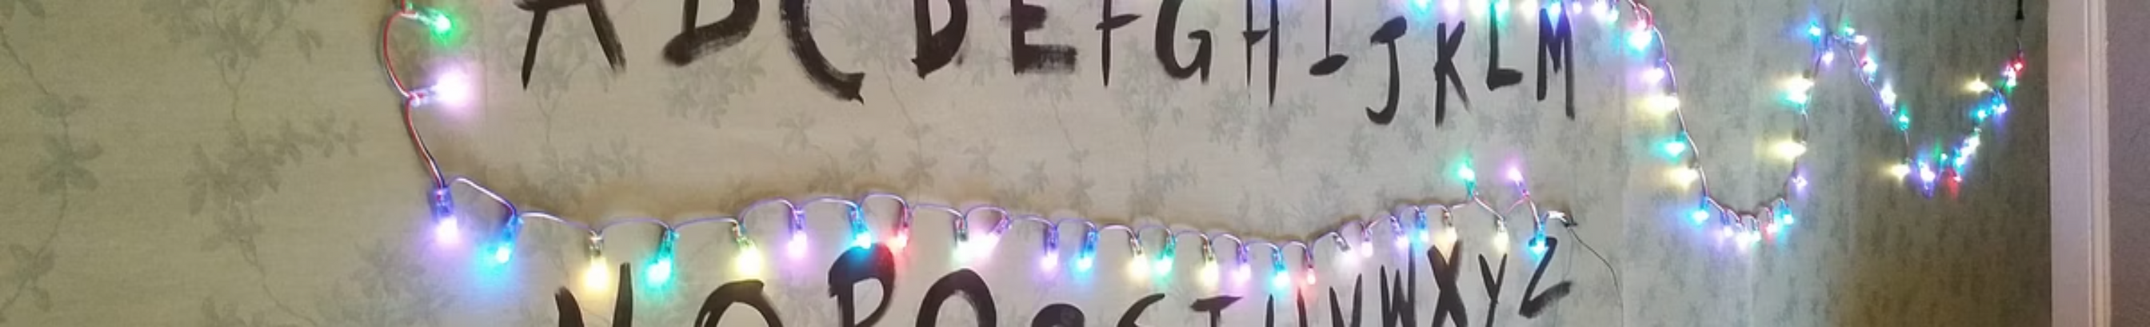

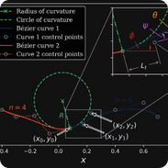

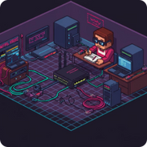
SIGNATURE FEATURE
Joyce's Alphabet Wall
Unseen Forces: Physics-Based Rendering
Messages from the Beyond: Dynamic Lighting
Hawkins A/V Club: Pixel-Perfect Retro
Wires rendered using SVG Bezier Curves with calculated natural "sag" effects—mirroring the unsettling pull of the Upside Down's gravity. It's not just a background image, but an authentic physics simulation, hinting at unseen forces at play.
Custom CSS filters apply pixelated, 8-bit aesthetics to bulbs and hand-painted letters, delivering that authentic vintage Hawkins feel—as if plucked straight from Dustin's tinkering bench.
Each C9 bulb casts real-time colored glows using box-shadow that illuminate the wall when active, much like Joyce's desperate signals, creating authentic depth and revealing truths from the other side.
Notes:
4

Slide 5
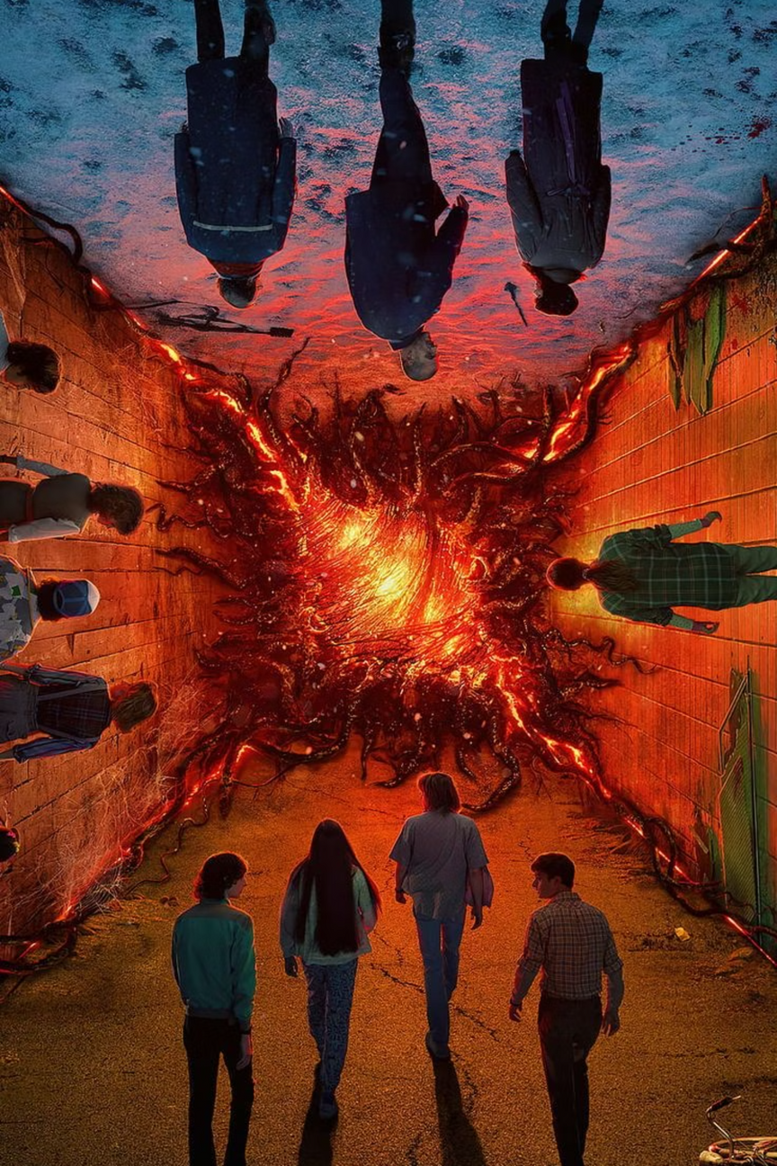
THE TWIST
Possession Mode
01
The Psychic Strain Meter
A "Sanity Meter," much like the mental vulnerability Vecna exploits, tracks the user's psychological stability. It gradually wanes with each interaction, drawing them deeper into the abyss.
02
When the Veil Thins
When the Sanity Meter hits rock bottom, the UI is violently hijacked—the screen plunges into the pitch-black void of the Upside Down, and control is ripped away, invoking a genuine horror that traps the user.
03
A Glimpse into the Corruption
After a suspenseful, chilling delay, a horrifying image of the Upside Down manifests, completing the terrifying possession experience and pulling the user into its distorted reality.
04
The Arcade Escape
To break free from the Upside Down's grip and reclaim their world, users must input the legendary Konami Code—a vital secret signal from the right side up, a perfect 80s Easter egg to save the day.
Notes:
6

Slide 6

HAWKINS LAB ENGINEERING
Unraveling the Upside Down's Code
1
2
Telekinetic Wire Dynamics in React
Dialing into the 80s: Retro-Reality in Modern Browsers
Problem: Static SVG lines felt like a false reality, unable to bend to the will of our responsive grid of flashing bulbs, much like trying to contain a nascent psychic power.
Problem: Modern screens, with their pristine clarity, threatened to sanitize the authentic '80s aesthetic, losing the grain and static essential to the true Hawkins experience.
Solution: Employed a custom getWireSagOffset function, channeling Eleven's precision to calculate the exact Y-position for each bulb, allowing them to snap into place as if guided by an unseen force along a quadratic Bezier curve.
Solution: We used image-rendering: pixelated to achieve that crunchy, 16-bit arcade feel, then applied mix-blend-mode: overlay for subtle, CRT-like scanlines, and disabled font smoothing for that classic blocky typography.
Notes:
7

Slide 7
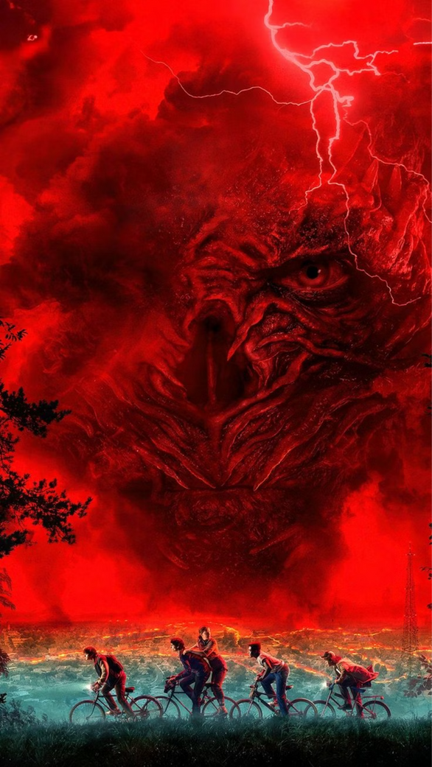
Unlocking the Upside Down's Tech Stack
React + TypeScript
Type-safe component architecture, robust as a walkie-talkie connection
Tailwind + Custom CSS
Rapid styling with precise control, crafting the '80s glow
Framer Motion
Smooth, performant animations, like Will's flickering lights
Zustand
Lightweight global state, tracking every Demogorgon sighting
Web Audio API
Spatial audio processing, bringing the whispers of the Upside Down to life
Notes:
8

Slide 8
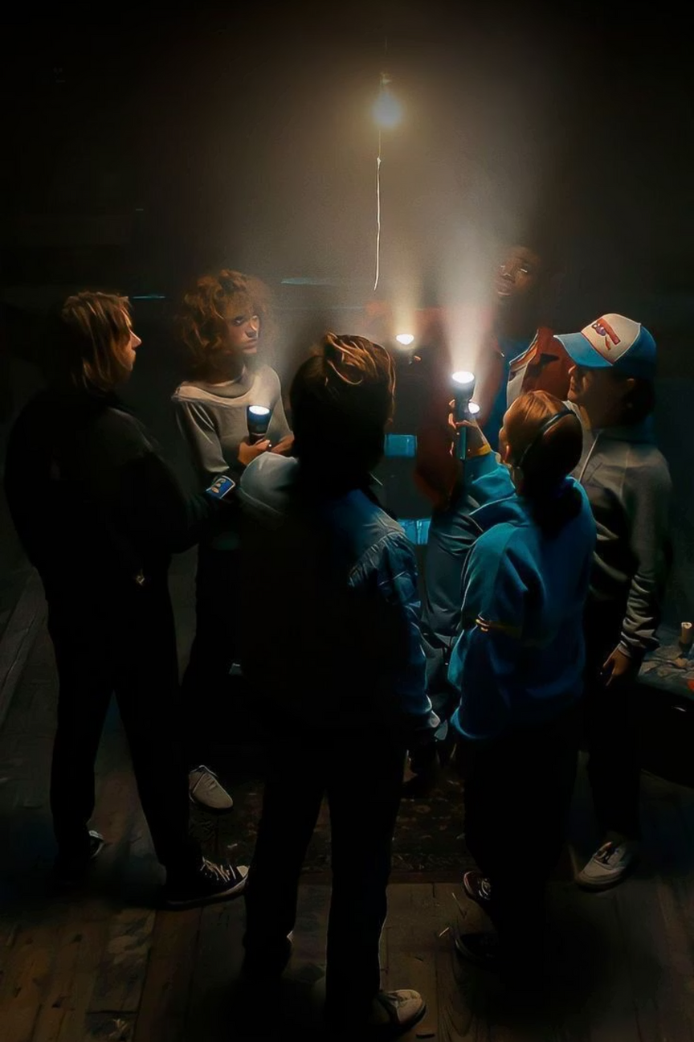
Breaching the Gate to the Upside Down
A technical feat, proving that modern web technologies can not only recreate authentic analog experiences but also pry open a digital rift, bridging the nostalgic charm of the '80s with an unsettling immersion into the unknown.
Our project, much like the clandestine endeavors of Hawkins National Laboratory, demonstrates how careful attention to detail, relentless problem-solving, and profound technical prowess can transmute a simple web interface into a chillingly unforgettable expedition through the very fabric of the Upside Down.
Notes:
10

Slide 9
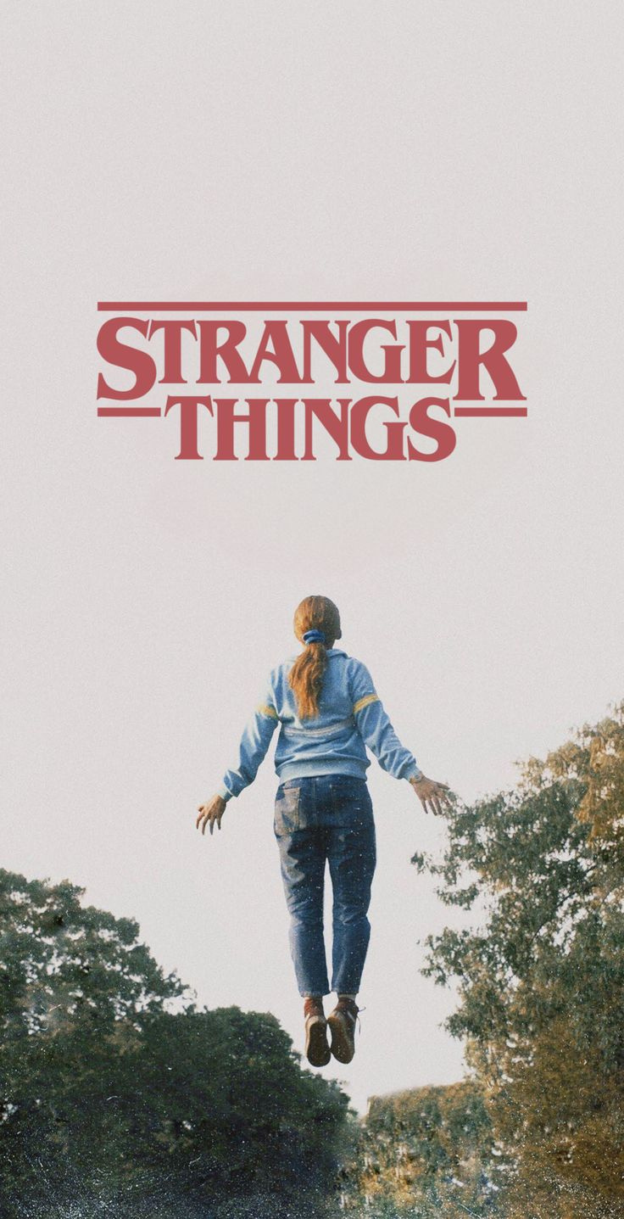
THANKYOU
TEAM MEMBERS
ABHISHEK SURESH-2547104
DINU DEVEES GEORGE-2547220
K ABHINASH PRABHU- 2548528
SHARON RAJU-2547153
GITHUB REPO: https://github.com/abhisheksuresh4/HawkinLab-Hackathon.git

